Slide 1

Environmental Factors Impacting the
Biotransformation of PFAS in Biosolids
Adrián Cardona Young & Tomás Schmieder
Drs. Natalie L. Cápiro, Pengfei Yan, & Sheng Dong
NYS Water Resources Institute (WRI) 2024 Intern Program
Notes:
Hi my name is Tomás, I am a rising junior studying environmental engineering
Hi my name is Adrián, I am a rising junior studying environmental engineering
Just want to start by saying thank you to Kristen and all of WRI for being great people and helpful throughout the entire summer.
We also want to thank Dr. Cápiro, Pengfei, and Sheng who were our mentors for this project.
As well thank you to the DEC staff that helped us out with gathering information and samples, Molly & Sally.
We will now present our project titled Environmental Factors Impacting the Biotransformation of PFAS in biosolids

Slide 2



What are Biosolids?
Nutrient rich organic matter byproduct of wastewater treatment.
They are a beneficial resource, containing essential plant nutrients that can be recycled as fertilizer for agricultural use.
Notes:
Adrian
Biosolids are a nutrient rich organic matter that are the byproduct of wastewater treatment plants. During the treatment of wastewater liquids and solids are separated.
After they are separated from each other they are treated, the solids are treated through physical and chemical processes which produces biosolids.
Biosolids are a nutrient and organic matter rich product. Due to these properties they become a great candidate for being repurposed and used as fertilizer to promote plant growth.
Nutrient rich organic matter, byproduct wastewater treatment plants.
Liquid and solids separated during treatment

Slide 3

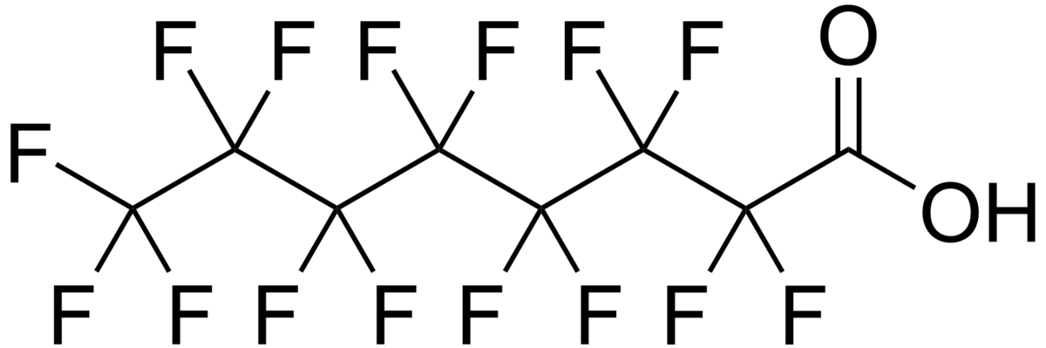
What are PFAS?
Per- and Polyfluoroalkyl substances, PFAS, are a group of thousands of synthetic chemicals that are used in many consumer products and industrial processes.
Notes:
Adrian
Per- and Polyfluoroalkyl substances, PFAS, thousands of synthetic chemicals that are used in many consumer products and industrial processes.
Non-stick pans, plastic packaging, waterproof gear, and aqueous fire fighting foam.
Long chains of carbon-fluorine bonds. Strongest bond in organic chemistry, it difficult to degrade.
Accumulate within their environment.
Found everywhere, from the glaciers of Antarctica to over 90% of humans that have been tested for them, these compounds are all around us.
Cancer, birth defects, & developmental delays. And since they don’t degrade they accumulate within us, steadily increasing their concentrations.

Slide 4









The Problem with PFAS in Biosolids
Notes:
Tomas
Since PFAS are nearly in everything that we deal with a large amount of it becomes apart of industrial and residential waste.
This waste ends up getting treated by waste water treatment plants, however, most of these plants are unable to treat the influent for PFAS.
Since PFAS isn’t being treated it ends up in the effluent of the wastewater treatment plant, that being the biosolids.
These biosolids which are then land applied and composted for agricultural use cause potential issues for contamination.
The PFAS can then leach from biosolids into groundwater which is used as a drinking water source.
As well it can be transpired by crops that we or animals may eat.
Following the food chain these compounds ultimately end up in humans, accumulating and causing health concerns.

Slide 5
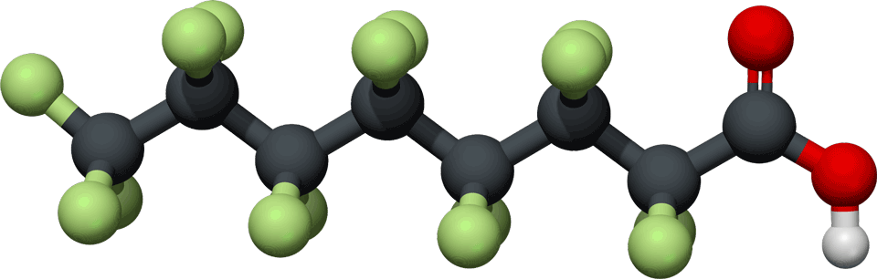
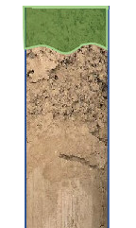

Our Project
Understand the processes that influence the fate, transport, and biotransformation of PFAS in biosolids.
Literature Review on PFAS and biosolids
Identify parameters that influence the leaching of PFAS from biosolids
Design an experimental system to mimic the field application of biosolids
Notes:
Adrian
Literature review on fate, transport, and biotransformation of PFAS in biosolids
Recent articles, different factors that affect fate and transport
Use knowledge gaps to identify potential for research.
Use this to inform experiment design and create literature review

Slide 6
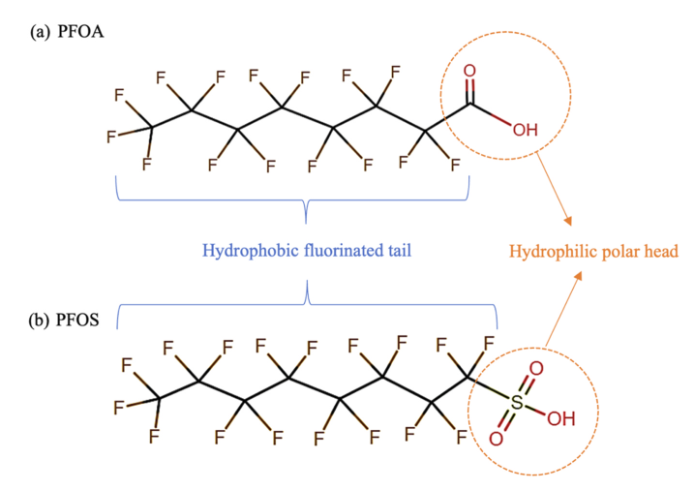
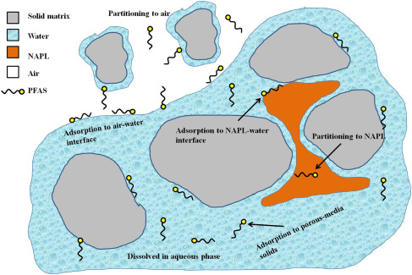
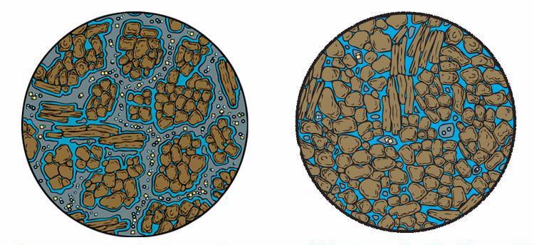
Parameters that affect Fate & Transport
Surface Area
Microbial Communities
Cation Concentrations
PFAS Tail and Head
PFAS Chain Length
Precipitation
Soil Permeability
Water Saturation
Porosity
Organic Carbon Content
We et al., 2023
Li and Liu, 2022
Mayer, 2021
Notes:
Adrian
Many factors.
Hydrophobic Sorption, Air-Water Interface Partitioning, and Electrostatic Adsorption.
Hydrophobic Sorption: soil composition, the amount of organic carbon, and the amount of surface area between particles of soil. These affect the amount of interactions that exist between the PFAS and the soil.
Air-Water Interface partitioning: composition of the soil and the surface area. PFAS align themselves along the interfaces between water and void space in soil, perfluoroalkyl tails in air and ionic functional group in water. Based on the fraction of water saturation in the soil, the impact of this process can be quite significant.
Electrostatic Adsorption: different component ions in Biosolids could have significant impacts in delaying transport of PFAS into the environment.
Microbial communities are some of the least understood. Microbial interactions may change PFAS, especially precursors to PFAAs which may be relevant for long term PFAS release
Understanding each of these processes and others creates a better understanding of what steps could be taken to reduce the amount of PFAS that ends up leaving biosolids and entering the environment where it could harm people and animals.

Slide 7
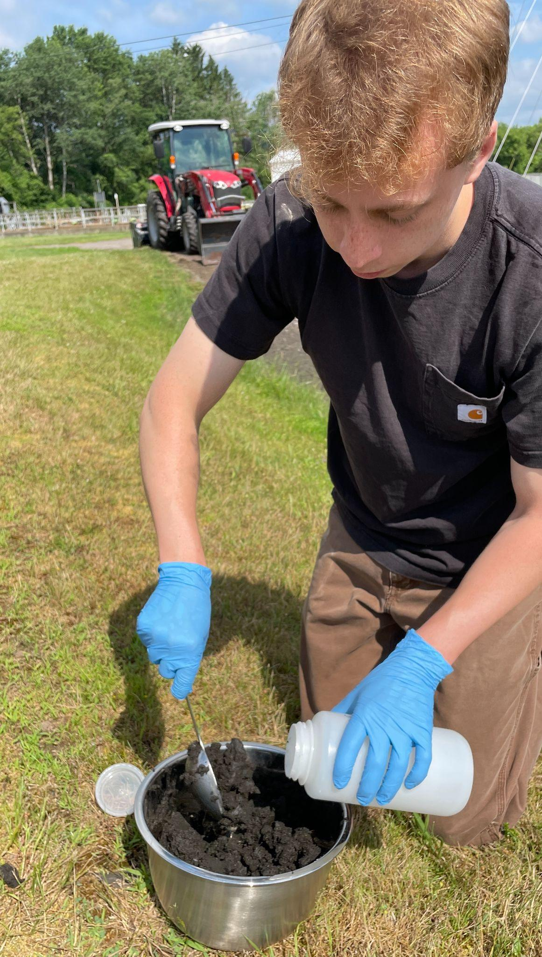
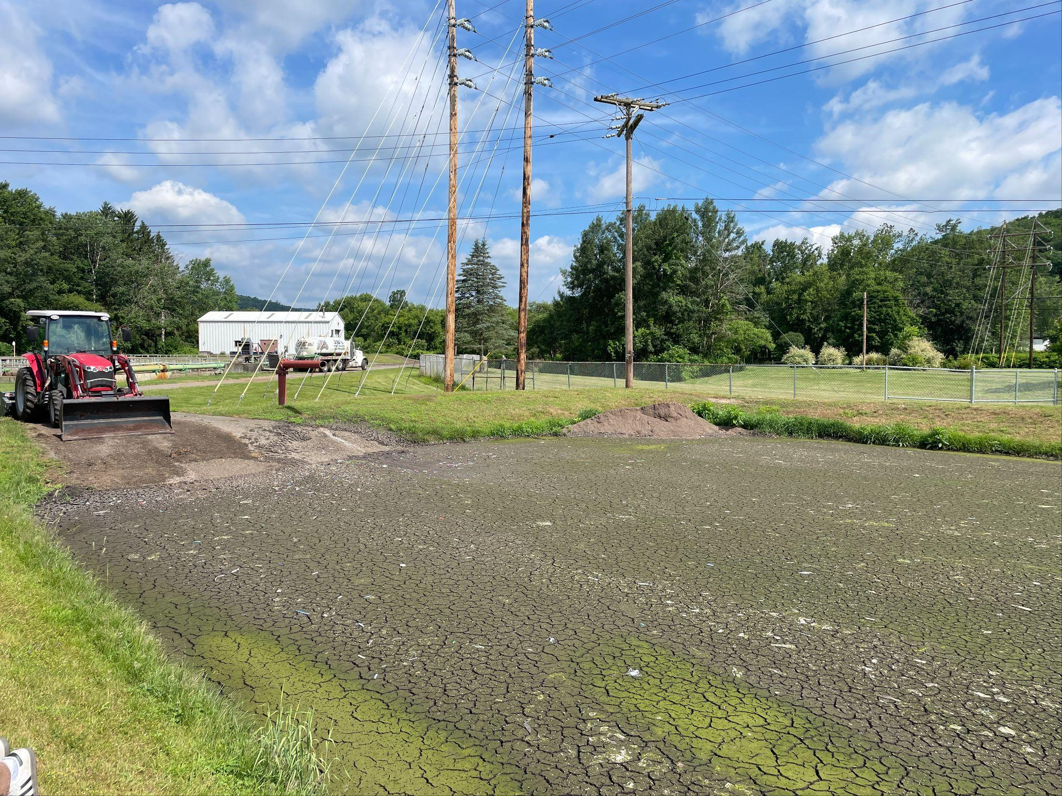
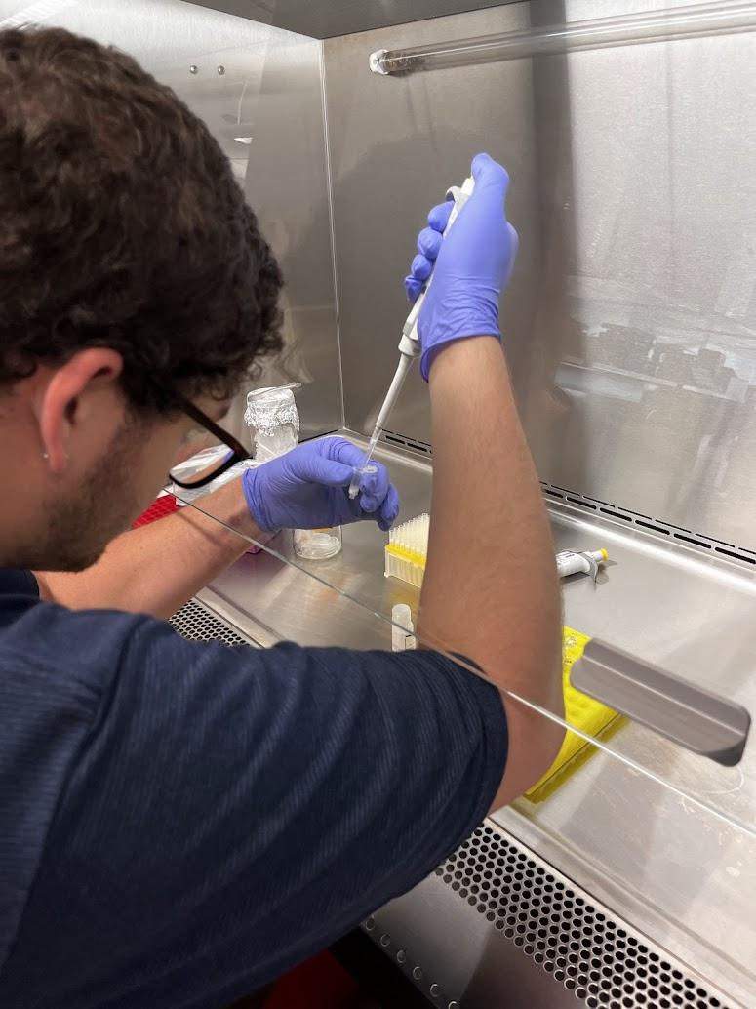
Sampling with the DEC
Getting biosolids samples
Biosolids at Sidney
DNA Extraction
Notes:
Tomas
Currently the NYS DEC is working with SUNY ESF to collect and test all biosolids that are being produced in NYS for PFAS.
Working with them we scheduled times that we could go and collect biosolids with them.
We collected biosolids from 3 locations, to add on to the two biosolids that Dr. Cápiro’s group had already collected from.
The biosolids samples were collected from Sidney, Deposit, Hancock, Albion, & Bergon.
Now having these biosolids samples we looked into characterizing parameters for these samples.
With help of the Cápiro lab we performed a DNA extraction on all of the biosolids samples, for each sample we isolated the microbial DNA which can be sequenced to identify the microbial communities present in the samples. As microbial weathering is a process that can impact the leaching of PFAS in biosolids it is a necessary parameter to understand how it might be influencing the fate, transport, and biotransformation of PFAS in biosolids.
But to better understand more factors that might influence the fate and transport of biosolids more research is necessary to be done.

Slide 8
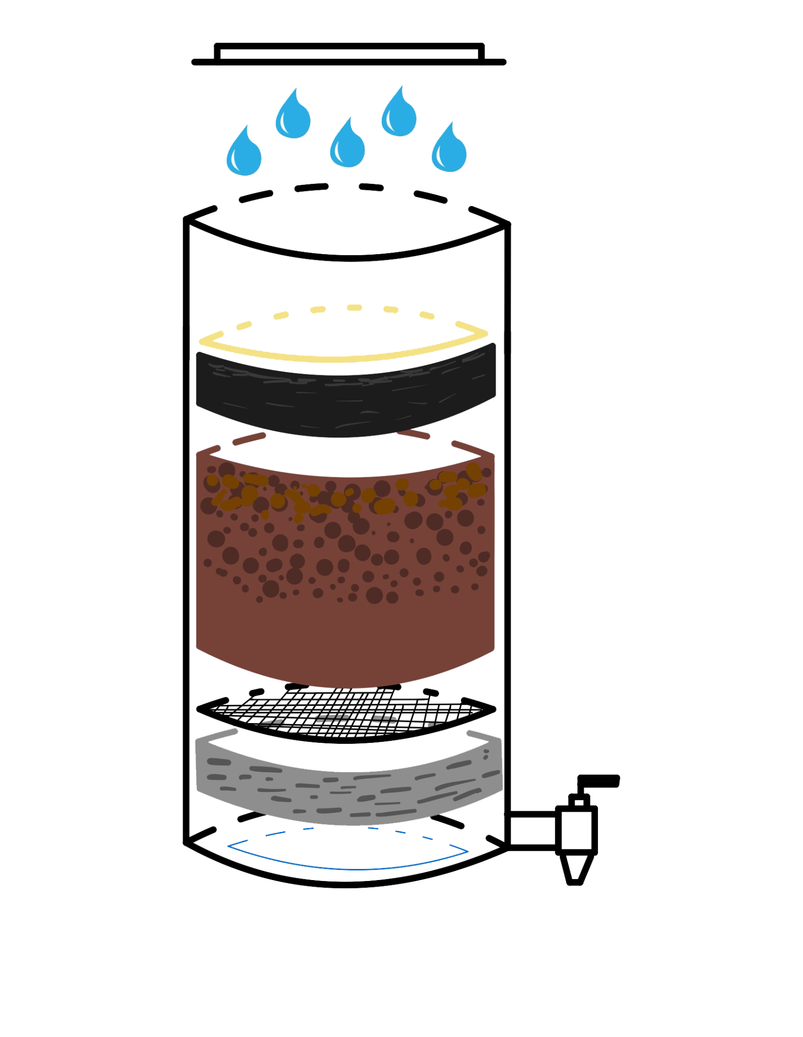
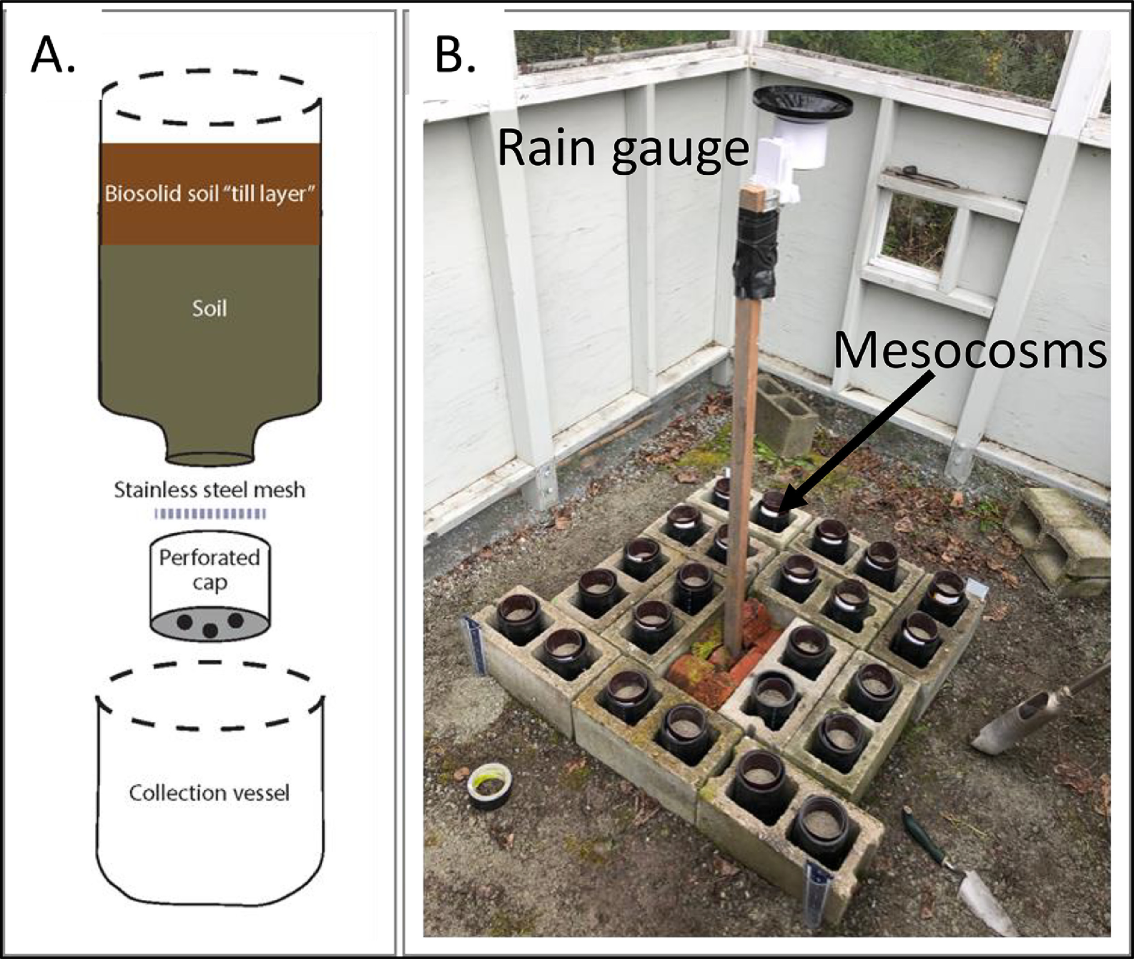
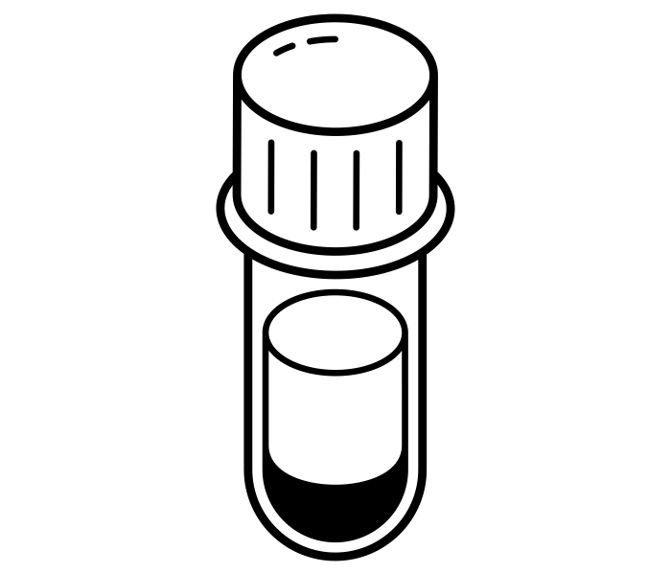
Experimental Setup
Schaefer, 2022
Precipitation
Filter Paper
Biosolids
Soil
Wire Mesh
Gravel
Water that leaches through will be tested for PFAS
Collection Valve
Notes:
Tomas
For more research to be completed on the topic of PFAS leaching experiments need to be conducted.
During our literature review we found examples of experiments that were completed to study the leaching of PFAS from biosolids into soil.
Using those as a reference we created our own experimental setup based off of Dr. Cápiro’s proposal for the project.
We also received feedback from Sally Rowland and Molly Trembley who are working with the DEC and SUNY ESF on the PFAS biosolids sampling, to better understand how we can simulate the realistic application of biosolids and PFAS leaching
Here is what we came up with,
We will be using a small HDPE container that will be stacked with a mixture of gravel, wire mesh, soil, biosolids and then a filter paper.
Water will then be precipitated onto the biosolids to simulate rainfall and start the leaching process of PFAS from biosolids.
Water that seeps through and accumulates at the bottom will then be collected and tested for PFAS.
All of the materials chosen are chosen to ensure that there is no possible PFAS contamination.
The soil is USGS characterized soil that comes from the Cornell Soil department
The biosolids that are being used are the ones that were collected from the DEC.
The container is made out of HDPE and the wire mesh is made out of stainless steel ensuring that these materials will not have interactions with PFAS.
The experiment would have duplicates, and triplicates of bottles to ensure that the results found were significant.
As well if it's found that at the beginning of the experiment the biosolids PFAS content is minimal then it is likely that a PFAS will injected into the biosolid, spiking it so that we can accurately see how it transforms.
By doing multiple experiments with multiple biosolids we are able to see how the PFAS leaching changes based on each of the parameters of the biosolids.

Slide 9
Next Steps
Use experimental set up to study PFAS leaching from biosolids
Get PFAS biosolids concentrations from SUNY ESF
Identify factors that affect leaching of PFAS in biosolids
Determine guidelines for the application of contaminated biosolids
Notes:
Adrian
Use experimental set up to conduct leaching experiments as part of future research. Incoming PhD student conducting research on microplastics sorption.
Will require obtaining information from SUNY ESF to characterize the biosolids.
Identify relevant factors, attempt to quantify them. Find sorption coefficients and partition coefficients.
Help inform guidelines for application of biosolids.

Slide 10
Thank you for listening!
Questions?
Notes:
Thank you for listening does anyone have any questions?

Slide 11
Thank You!
Tomás Schmieder | tas274@cornell.edu
Adrián Cardona Young | alc354@cornell.edu
Molly Brown | meb394@cornell.edu
Molly Corley | mkc238@cornell.edu
Gianna Haro | gh439@cornell.edu
Sarah Cooke | sec275@cornell.edu
Notes:
Thank you for the questions, that wraps up of the 2024 NYS WRI intern webinar. Huge shout out to all of the WRI staff and everyone we all worked with, thank you for the opportunity and the help

